Slide 1
Weekly Report: Management Team
Presented by: Federico De Mita & Bakhtyar Karim/ Josef Remberger

Slide 2
List of contents
Main Design Parameters
Rated Rotor Speed from Benchmarks
Tip Speed
Comparsion with Benchmarks
Tip Speed Ratio
Comparsion with Benchmarks
Tip Speed selection
Why starting with tip speed?
Tip speed design drives
Noise regulations
Final decision

Slide 3
1. Main Design Parameters
Main parameters:
1. Rated rotor speed (n)
2. Tip speed (U_tip)
3. Tip-speed ratio (λ)
4. Average site wind speed: 9 m/s (IEC IIIa)
Why We Define These Parameters
Ensure consistent aerodynamic and drivetrain inputs for all teams.
Base design decisions on certified 5 MW-class benchmark turbines.
Support early modeling of rotor, gearbox, and electrical drivetrain.
[8]
Bakhtyar Karim

Slide 4
1. Rated Rotor Speed
Industry Benchmarks
Turbine Model | Rotor Ø [m] | Rated Power [MW] | Rated Speed [rpm]
GE Cypress 5.3-158 | 158 | 5.3 | 10.5
Nordex N163/5.X | 163 | 5.7 | 9.5
Siemens SG 5.0-145 | 145 | 5.0 | 12.0
NREL 5 MW Reference | 126 | 5.0 | 12.1
5 MW turbines with 145–165 m rotors typically operate between 9–12 rpm.
Selecting n = 10 rpm keeps the 160 m rotor within this range.
Compatible with 3-stage gearbox (≈1 : 160) and DFIG speed 1000–1800 rpm.
[1] [2] [3] [5]
Bakhtyar Karim

Slide 5
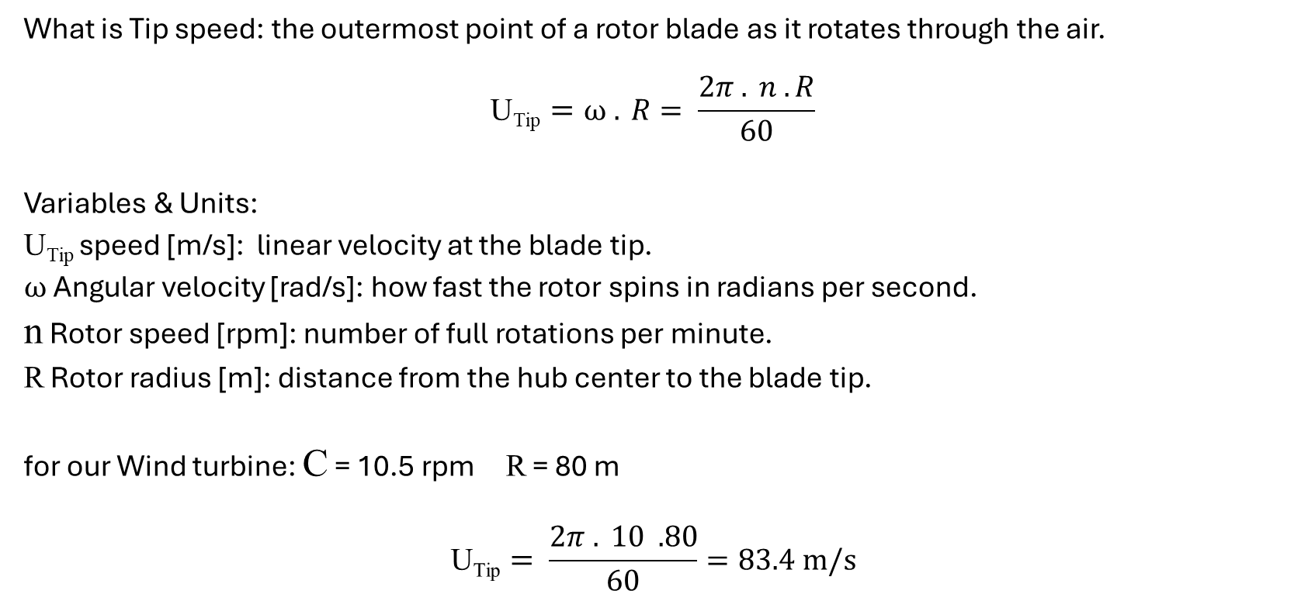
2. Tip Speed
What is Tip speed: the outermost point of a rotor blade as it rotates through the air.
$$\text{U}\text{Tip}=ω . R= \frac{2π . n .R}{60}$$
Variables & Units:
$\text{U}\text{Tip}$speed [m/s]: linear velocity at the blade tip.
$ω$ Angular velocity [rad/s]: how fast the rotor spins in radians per second.
n Rotor speed [rpm]: number of full rotations per minute.
R Rotor radius [m]: distance from the hub center to the blade tip.
for our Wind turbine: C = 10.5 rpm R = 80 m
$$\text{U}\text{Tip}= \frac{2π . 10 .80}{60}=83.4 m/s$$
[5] [6] [7]
Bakhtyar Karim

Slide 6
2.i. Comparsion with Benchmarks
Turbine | Rotor Ø [m] | Rated Speed [rpm] | Tip Speed [m/s]
Siemens SG 5.0-145 | 145 | 12.0 | 91
Nordex N163/5.X | 163 | 9.5 | 81
GE Cypress 5.3-158 | 158 | 10.5 | 87
Goldwind GW155/4.5 | 155 | 10.0 | 81
Vestas V150-5.6 | 150 | 11.0 | 86
Optimus Syria | 160 | 10 | 83.4
From Benchmarks Tip speed is ≈ 80–90 m/s for modern 5 MW turbines.
Why it is Important to determine Tip speed?
Determines aerodynamic efficiency, noise, and structural loading.
[1] [2] [3] [4] [5] [6]
Bakhtyar karim

Slide 7
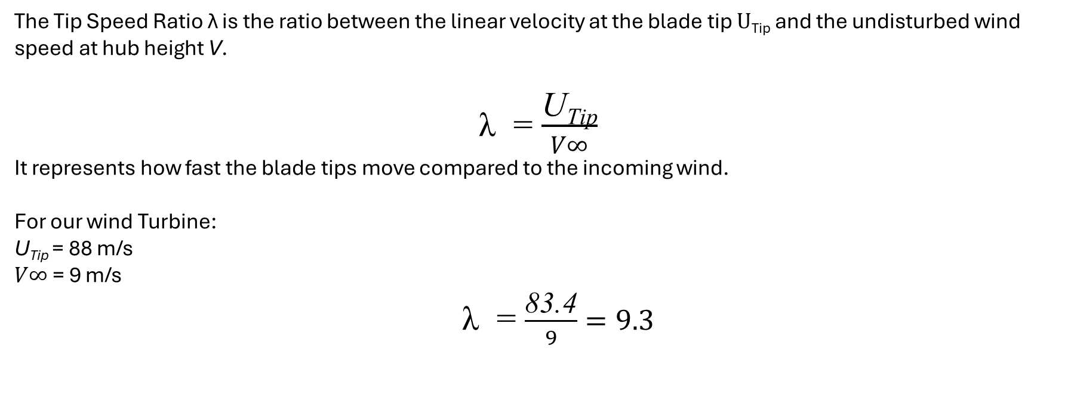
3. Tip Speed Ratio
The Tip Speed Ratio λ is the ratio between the linear velocity at the blade tip $\text{U}\text{Tip}$ and the undisturbed wind speed at hub height V.
λ = $\frac{\text{U}\text{Tip}}{V∞}$
It represents how fast the blade tips move compared to the incoming wind.
For our wind Turbine:
$\text{U}\text{Tip}$= 88 m/s
$V∞$= 9 m/s
λ = $\frac{\text{83.4}}{9}=9.3$
[4] [5]
Bakhtyar karim

Slide 8
3.i. Comparsion with Bnechmarks
Turbine | TSR Range
NREL 5 MW Reference | 7.5
Siemens SG 5.0-145 | 8 – 9
Nordex N163/5.X | 8.5 – 9.5
GE Cypress 5.3-158 | ≈ 9
Goldwind GW155/4.5 | 8.8
Vestas V150-5.6 | 8.5 – 9
Optimus Syria | ≈ 9.3
Interpretation
λ ≈ 7.5 – 10 is optimal for IEC IIIa (9 m/s mean wind).
Higher λ is better energy capture at low wind.
Too high λ leads to high noise & stress increase.
[1] [2] [3] [4] [5] [6] [7]
Bakhtyar karim

Slide 9
Bibliography / Management team / PM
[1] Siemens Gamesa Renewable Energy, “SG 5.0-145 Onshore Wind Turbine,” Siemens Gamesa, 2024. [Online]. Available: https://www.siemensgamesa.com/en-int/products-and-services/onshore/wind-turbine-sg-5-0-145
[2] Nordex SE, “N163/5.X – Delta4000 Platform,” Nordex Group, 2024. [Online]. Available: https://www.nordex-online.com/en/product/n163-5-x/
[3] GE Vernova, “Cypress Platform – 5.3-158 MW Onshore Wind Turbine,” GE Renewable Energy, 2024. [Online]. Available: https://www.gevernova.com
[4] P. Bortolotti, J. J. Jonkman, L. Wang and A. D. Wright, “IEA Wind TCP Task 37: Systems Engineering in Wind Energy – Reference Wind Turbines,” NREL, 2019. doi: 10.2172/1529216.
[5] National Renewable Energy Laboratory (NREL), “NREL 5 MW Reference Turbine Documentation,” Golden, CO, 2020. [Online]. Available: https://docs.nrel.gov/docs/fy09osti/38060.pdf [6] Goldwind, “GW155/4.5 Wind Turbine Product Brochure,” Xinjiang Goldwind Science & Technology Co., Ltd., 2023. [Online]. Available: https://www.goldwind.com
[7] Vestas Wind Systems A/S, “V150-5.6 MW EnVentus Platform,” Vestas, 2024. [Online]. Available: https://www.vestas.com
[8] DNV, “Design Guideline for Certification of Wind Turbines (DNV-ST-0437),” DNV, Høvik, 2021.
Bakhtyar Karim

Slide 10
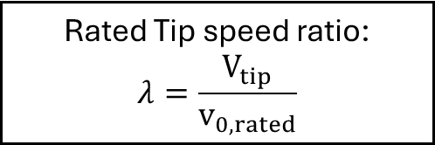
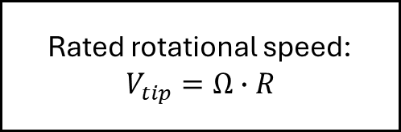
2.i Why starting with tip speed?
Design idea:
TIP SPEED
Rated Tip speed ratio:
$$λ=\frac{V_{tip}}{v_{0,rated}}$$
Rated rotational speed:
$$V_{tip}=Ω∙R$$
Mechanical torque calculation
Power coefficient calculation

Slide 11
2.ii Tip speed design drives
Main drives for tip speed calculation:
Main focus for Optimus Syria
1.Noise
2. Low Mechanical torque
LCOE
Can be also reduced by optimizing a high tip speed
3. More expensive rotor bearings
CAN BE REGULATED THORUGH TURBINE CONTROLLER
[1],[2]

Slide 12
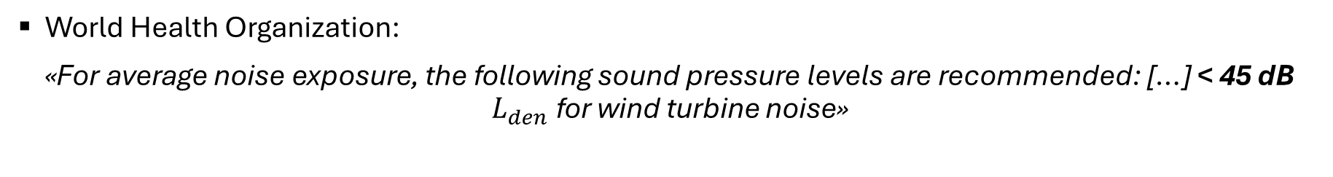
2.iii Noise regulations
Syria does not have any available source regarding wind turbines (or general ones either)
Thus, we have to refer to other standards from the nearby countries or from international standards:
World Health Organization (WHO)
Egyptian standards
Turkish standards
World Health Organization:
«For average noise exposure, the following sound pressure levels are recommended: […] < 45 dB $L_{den}$ for wind turbine noise»
[3]

Slide 13
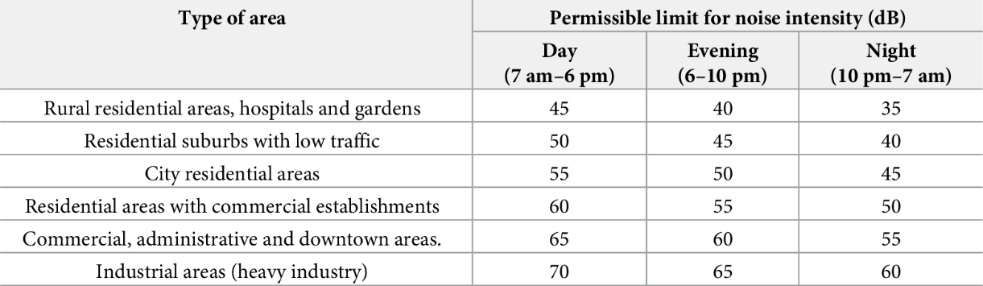
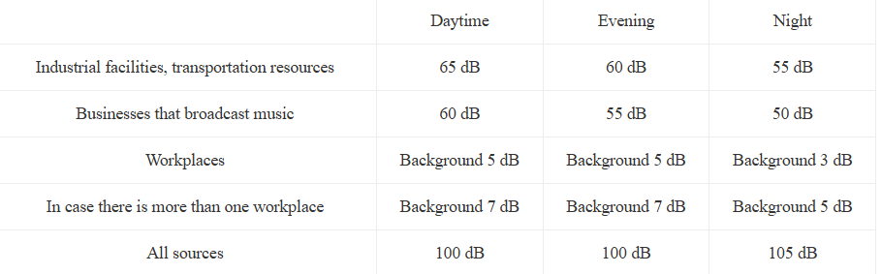
2.iii Noise regulations
Egyptian standards: Egyptian Environmental Law No. 4/1994 [4]
Turkish standards: Noise Control Regulation [5]

Slide 14
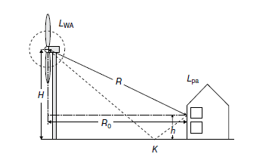


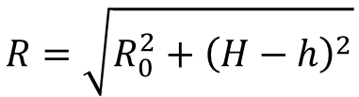
2.iv Final decision
Based on a comparison between the different values and a collaboration with the project development team:
$$L_{des}=65 dB$$
Starting then from the formulas found in [6]:
(1)
$$L_{WA}≈50\log_{10}\left(v_{tip}\right)+10\log_{10}\left(D\right)−4$$
For the source sound level
(2)
$$L_{pa}=L_{WA}−10\log_{10}\left(4πR^{2}\right)+3$$
For the noise propagation
With R = distance from the hub to the first house in the nearbies of the site:
$$R=\sqrt{R_{0}^{2}+{\left(H−h\right)}^{2}}$$
$$(h=5 m)$$
[6] Undertanding Wind Power Technology, A. Schaffarczyk, 2014

Slide 15
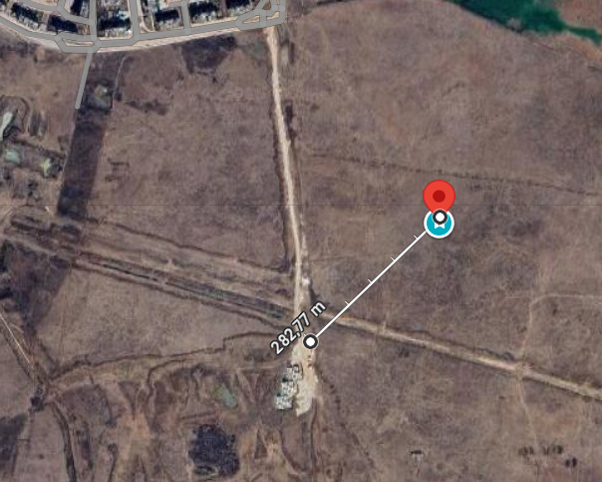


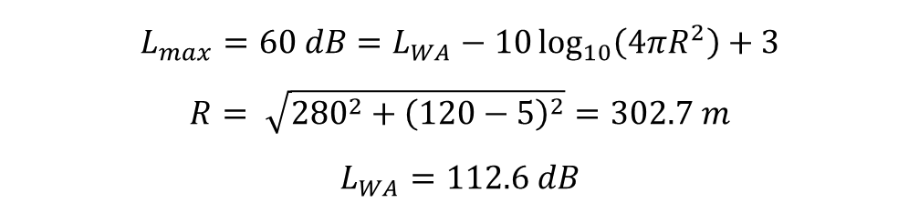
2.iv Final decision
Distance from the closest household: $\sim 280 m$
We assess the maximum allowable noise level from the source as:
$$L_{max}=60 dB=L_{WA}−10\log_{10}\left(4πR^{2}\right)+3$$
$$R= \sqrt{{280}^{2}+{\left(120−5\right)}^{2}}=302.7 m$$
$$L_{WA}=112.6 dB$$
From this value we can obtain the maximum allowable tip speed for this house from the Equation (1)
We reduce the $L_{max}$ to 58 dB:
$$v_{tip,fin}=89 m/s$$
$$Ω=10.67 rpm$$
$$V_{tip,max}=98 m/s$$
Very high compared to the benchmark values!

Slide 16
Bibliography – Management team
[1] “Variable Speed Control for Wind Turbine Acoustics.” Accessed: Oct. 10, 2025. [Online]. Available: https://xray.greyb.com/wind-turbines/variable-speed-noise-reduction
[2] A. Ning and K. Dykes, “Understanding the benefits and limitations of increasing maximum rotor tip speed for utility-scale wind turbines,” J Phys Conf Ser, vol. 524, no. 1, 2014, doi: 10.1088/1742-6596/524/1/012087.
[3] “Chapter 11. Environmental noise,” 2022.
[4] Y. A. Farghaly, F. A. A. Hemeida, and S. Salah, “Noise utilization as an approach for reducing energy consumption in street lighting,” PLoS One, vol. 14, no. 7, p. e0219373, Jul. 2019, doi: 10.1371/JOURNAL.PONE.0219373.
[5] “Rüzgâr türbinlerinin gürültü etkisi | temizmekan.” Accessed: Oct. 10, 2025. [Online]. Available: https://www.temizmekan.com/ruzgar-turbinlerinin-gurultu-etkisi/
[6] A. Schaffarczyk, “Understanding Wind Power Technology.”, 2014

